Slide 1
Archisurance: The Future
A presentation by:
Alina Rozenbaum
David Loveless
Kevin Li

Slide 2

What you’ve got to What you Want
Newly/partially integrated Archisurance
We need to bring this together.
Remove redundancies and utilize the group.
Bancassurance and why we want it.
What is bancassurance?
What are the benefits?
How does this help you?
Notes:
You have already outlined a large portion of where we want to start expanding, but we need to bring the back offices together.
Bancassurance – selling insurance through the banks customer contact.
The ability to contact a large number of possible customers that are in a position to get your services.
Also helps bring additional revenue through loan investments.
At the end ask if there are any comments or questions on this portion.

Slide 3
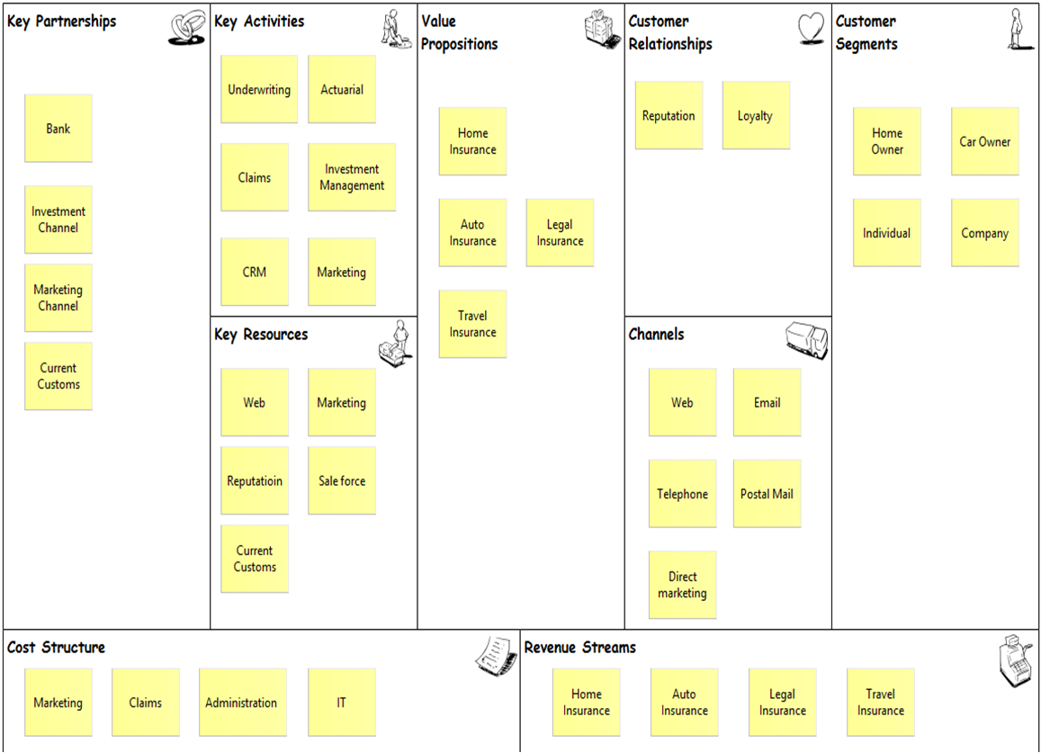
Business Model Canvas of ArchiSurance
Notes:
This is a basic representation of the model you are currently working with. As well as the customer value, cost, and revenue sources.
We will return to this view.

Slide 4
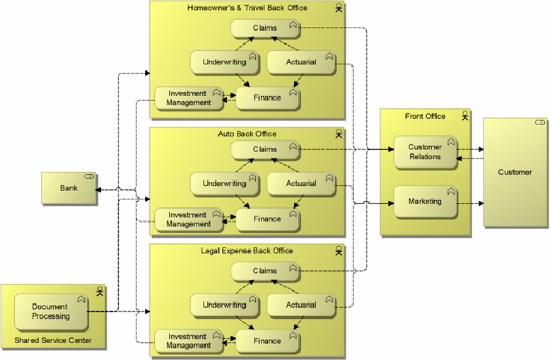
Where you are now
Notes:
Here is what you currently have.

Slide 5


Business Function view of ArchiSurance
Home & Away
PRO-FIT
Legal Expenses
Front Office
Claims
CRM
Underwriting
Actuarial
Marketing
Share Service Center
Investment Management
Document Processing
Finance
Notes:
This is what we understand you want to look like.

Slide 6
ArchiSurance information structure
Customer
Insurance File
Insurance Request
Insurance Policy
Claim
Travel
Homeowner
Auto
Legal Expenses

Slide 7
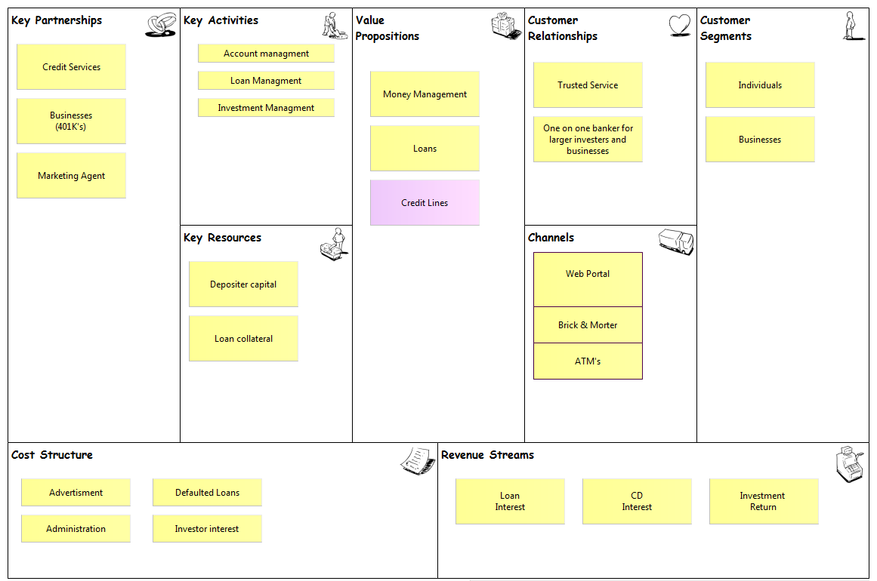
General Bank Model
Notes:
A general view of a bank Model.

Slide 8

Business Function view of Bank
Document Processing
Loan Request
Front Office
CRM
Underwriting
Loan Review
Marketing
Investment Management
Finance
Deposits
Money Account
Notes:
Similar in such ways that can provide specific expertise that will help the financial side of things.
Since the Front office can operate in conjunction they can sell each others services.

Slide 9
Bank Information Structure
Customer
Customer Account
Checking
Loans
Savings
Home
Auto
Business

Slide 10
Synergies
ArchiSurance
Multi-Branch
Large Customer Base
Front Office
Online sales
Investment
Handle customers’ financial information
Bank
Multi-Branch
Large Customer Base
Online Management
Financial Expertise
Investment Expertise
Notes:
We will be discussing this through out the presentation.

Slide 11
Bancassurance
Bancassurance means selling insurance product through banks.
Banks and insurance companies come up in a partnership wherein the bank sells the partner company's insurance products to its clients.

Slide 12
Suggestion
Use each other’s customer information, try to expanding customer group; e.g. Auto Loan taker also Auto insurance, same as Homeowners.
Expanding customer base by using each other’s branches; e.g. Bank Teller promotes sales in insurance and the Insurance company helps promote Credit Card.
Share business front and information; e.g. One account has access to both bank and insurance information; Guarantees insurance premium by connecting to the bank account and promotes personal insurance plan by analysis of the finance condition.
Saves money by bank managing investments, also brings capital to the bank.

Slide 13
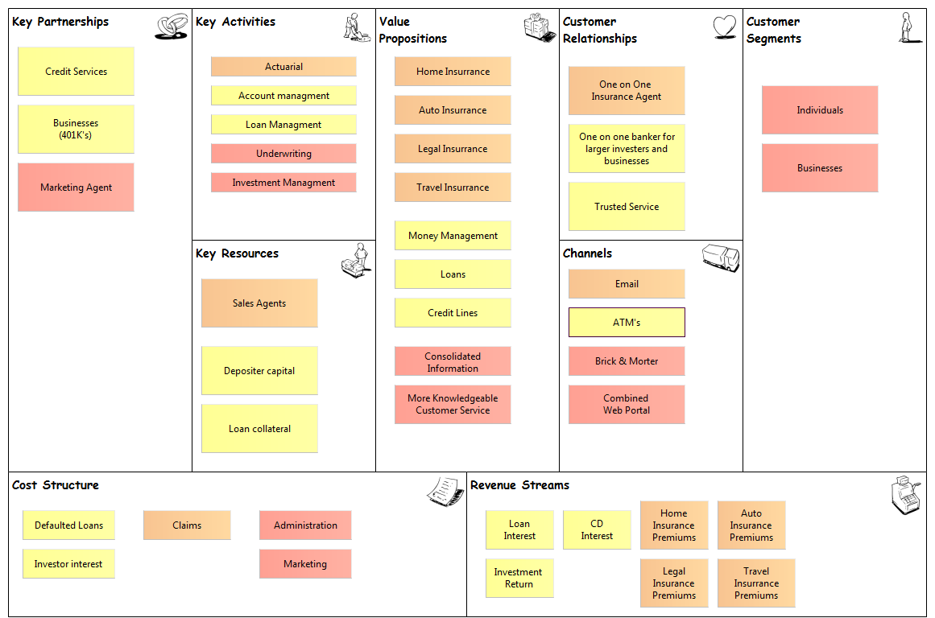
New Archisurance
Notes:
Here you can see the combined final view of the benefits bancassurance can provide. The multitude of Value options of the customer can bring them in, but then they will have a view of the other multitude of Value option of the customer can bring them in, but then they will have a view of the other multitude to be sold on.

Slide 14
New Function View
Internal Offices
Insurance
HeadQuarters
Front Office
Actuarial
HP Enterprise Cloud
Back-Ups
Document Management
Claims
Brick & Mortar
Bank
Web Portal
Customer Bank
CRM
Investment Management
Human Resources
Underwriting
Insurance Banking
& Finance
Notes:
The bank provides a structural view for the customer, and customers will come for the one access for all there financial and insurance needs.
The HP Enterprise Services eliminates the need to maintain a second office building and inherently provides backup services. The CRM will be the only in house operated services. The CRM will be the only in house operated servers.
The bank also allows for the specialized management of Financial and Investment aspects.

